Slide 1
(EM)CCD Model Review: Overview and Validation Efforts
Nicholas Jones (njones31@vt.edu)
Mission Systems Division, National Security Institute

Slide 2
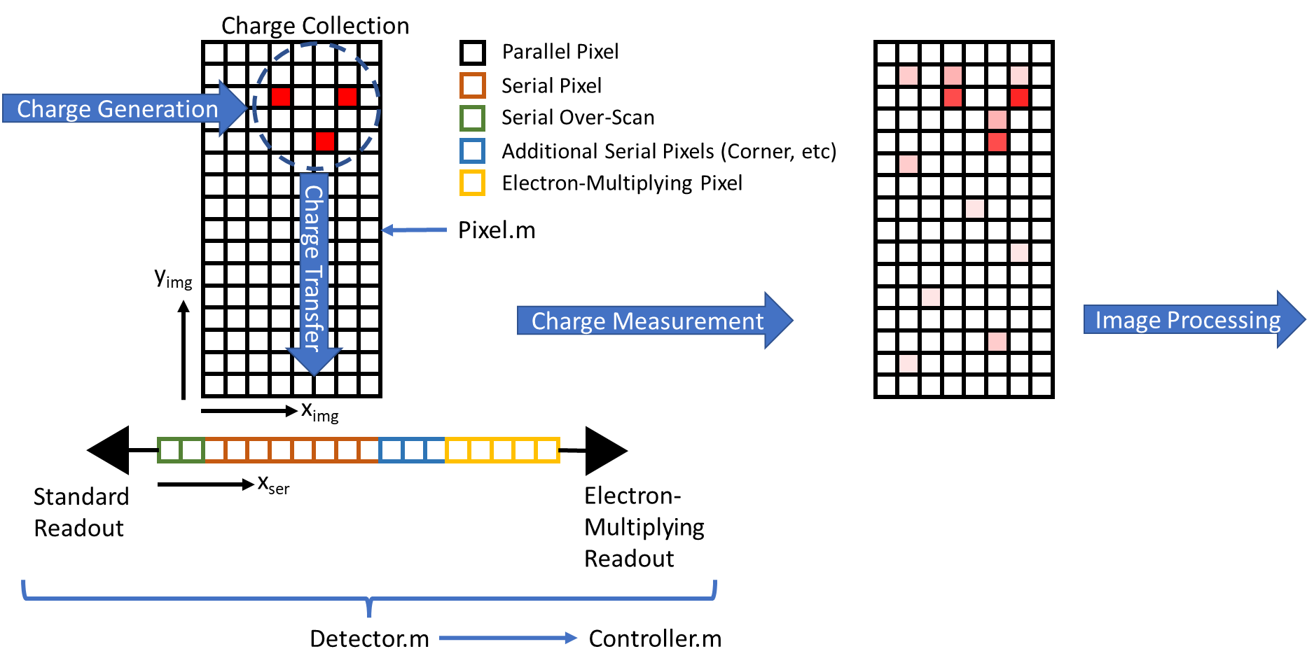
Model Overview
(EM)CCD model has been implemented in MATLAB to simulate detector operations at high fidelity
Charge Generation
Charge Collection
Charge Transfer
Charge Measurement
Noise Processes
The detector is modelled at the individual pixel level
Modelling of pixel level defects
Explicit definition and execution of read-out sequences

Slide 3
Pixel
Lowest level representation is the Pixel class
Used to store information regarding pixel state and properties
By setting different properties, different pixel functions can be modelled (image section, transfer section, serial pixel, etc)
Amount of charge is stored in the charge cloud for each pixel
iQE and QY are stored as wavelength dependent values
Property | Description
Interacting Quantum Efficiency | Determines the number of incident photons that generate an e-h pair (0 – 1)
Quantum Yield | Determines the probability of an interacting photon producing a second e-h pair (≥ 1)
Full Well Capacity | Sets the capacity of each pixel (e⁻)
Charge Transfer Efficiency | Determines the amount of charge transferred (0 – 1)
Dark Current Rate | Dark current generation rate (e⁻ s⁻¹)
Clock – Induced – Charge Rate | Mean CIC rate, defined per transfer (e⁻ transfer⁻¹)
Multiplication Probability | Probability of electron multiplication per electron within the pixel (0 - 1)
Constant | Value
Average e-h pair production energy | 3.65 eV
Fano Factor for Silicon | 0.1

Slide 4
Detector
Contains Pixel object arrays representing the parallel and serial sections
Coordinates transfer of charge between pixels
Allows for setting pixel level properties within the array to simulate non-uniformities and defects
Properties can be set independently between the parallel and serial sections
Both standard and EM outputs are modeled
Property | Description
Parallel Section Length / Width | Size of the parallel section (Pixels)
Serial Register Overscan | Number of overscan elements in the serial section before the standard readout (Pixels)
Serial Additional Elements | Number of elements in the serial register between the image section and EM elements (corner, etc.) (Pixels)
Serial Multiplying Elements | Number of electron – multiplying elements in the serial register (Pixels)
EM / STD Read Noise | RMS read-out noise for the read-out amplifier (e⁻)
EM / STD Read Bias | Bias applied to the read-out (e⁻)
Mean Gain | Sets the mean gain for the detector. Along with the number of multiplying elements, calculates the correct multiplication probability for individual pixels.

Slide 5
Controller
Contains and coordinates access to a Detector object
Coordinates the readout sequence of the detector
Used to control horizontal and vertical frequencies, application of the camera gain constant, and digitization of the read-out
Supports modification of properties at the pixel level for degrading dark current generation and CTE performance in the parallel and serial sections
Property | Description
Camera Gain Constant | Controls conversion between e⁻ to DN at the detector read-out (e⁻ DN⁻¹)
ADC Resolution | Sets the number of bits used by the ADC (# bits)
ADC Offset | Sets any offset in the ADC corresponding to the 0 level of the readout (DN)
Vertical Frequency | Sets the frequency for vertical transfers (Hz)
Horizontal Frequency | Sets the frequency for horizontal transfers (Hz)

Slide 6
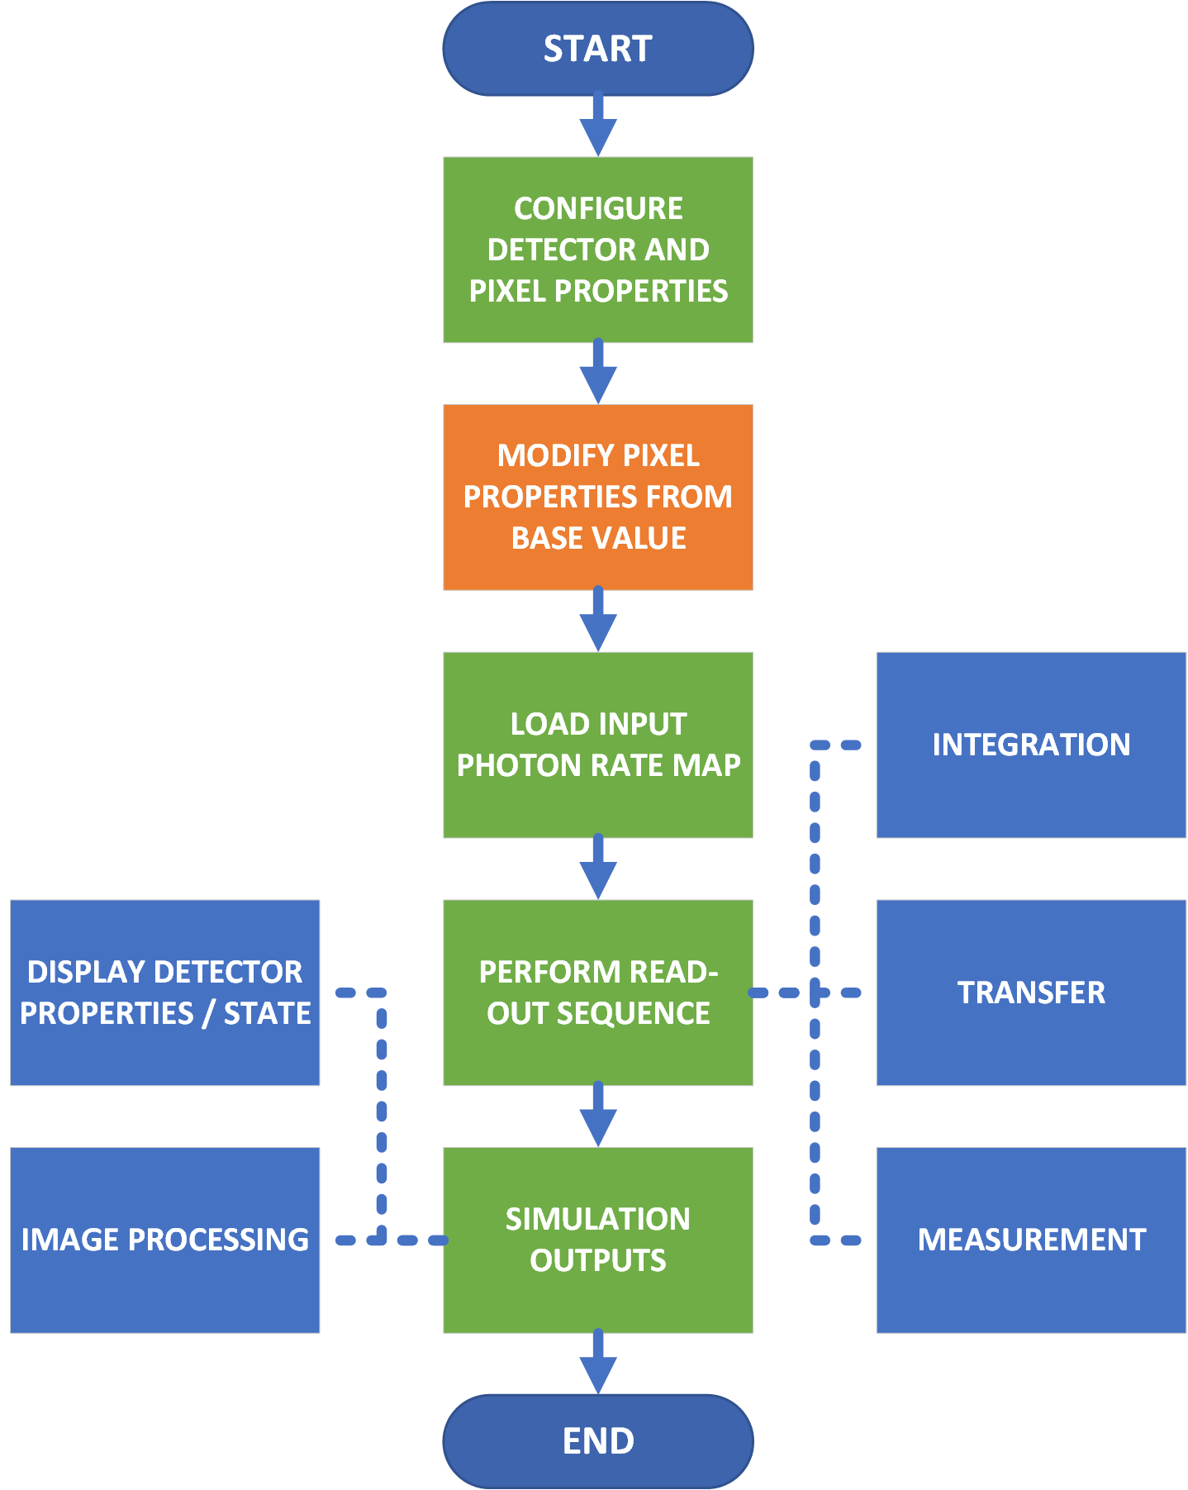
Code Overview
Process | Model | Notes | Reference
Incoming Photons | Poisson Distribution | Shot Noise
Photon Interaction | Binomial Distribution | Interacting Quantum Efficiency
Quantum Yield | Binomial / Normal Distribution | Fano Noise | [1, 2, 3, 4]
Dark Current | Poisson Distribution
CIC | Poisson Distribution
Charge Transfer Efficiency | Binomial Distribution
Electron Multiplication | Binomial Distribution | Captures ENF | [5]
Read Noise | Normal Distribution

Slide 7
Charge Generation
Incoming Photons
Specified for a specific wavelength
Multiple wavelengths of light can be incident on a detector simultaneously
Implemented as map of incoming mean photon incidence rate over the parallel section of the array
Specified in mean photons per seconds
Charge is generated for all steps of the process for which a finite time interval is defined
Includes integration times and during vertical and parallel transfers
The number of photons incident on a pixel over a time interval is determined by multiplying the mean photon incidence rate by the time interval, then using this mean number of incident photons to feed a Poisson random number generator to simulate shot noise
The number of interacting photons is then determined by the interacting quantum efficiency
A binomial distribution is used, where each interacting photon is a “trial”, and the probability of successfully interacting with the pixel is set by the interacting quantum efficiency.
Interacting quantum efficiency is input as a wavelength-dependent vector
Interpolation can be done using a ‘linear’ or ‘nearest’ method

Slide 8
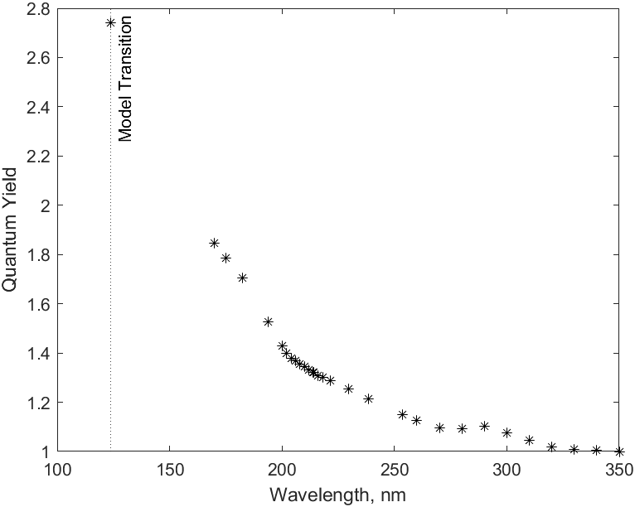
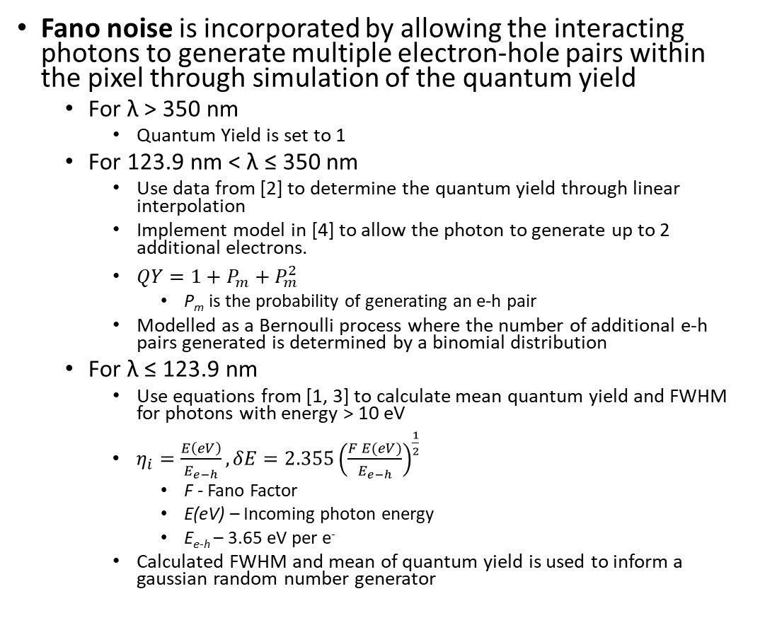
Charge Generation
Fano noise is incorporated by allowing the interacting photons to generate multiple electron-hole pairs within the pixel through simulation of the quantum yield
For λ > 350 nm
Quantum Yield is set to 1
For 123.9 nm < λ ≤ 350 nm
Use data from [2] to determine the quantum yield through linear interpolation
Implement model in [4] to allow the photon to generate up to 2 additional electrons.
$QY=1+P_{m}+P_{m}^{2}$
P_{m} is the probability of generating an e-h pair
Modelled as a Bernoulli process where the number of additional e-h pairs generated is determined by a binomial distribution
For λ ≤ 123.9 nm
Use equations from [1, 3] to calculate mean quantum yield and FWHM for photons with energy > 10 eV
$η_{i}=\frac{E\left(eV\right)}{E_{e−h}},δE=2.355{\left(\frac{F E(eV)}{E_{e−h}}\right)}^{\frac{1}{2}}$
F - Fano Factor
E(eV) – Incoming photon energy
E_{e-h} – 3.65 eV per e⁻
Calculated FWHM and mean of quantum yield is used to inform a gaussian random number generator

Slide 9
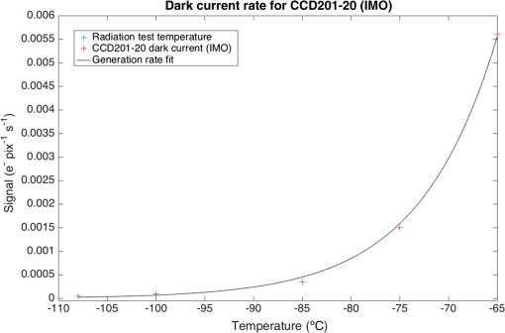
Charge Generation
Dark Current
The mean dark current generation rate, along with the time interval, are used to inform a Poisson distribution to generate dark current over each interval
[6]

Slide 10
Charge Collection
Model currently assumes perfect performance for charge collection parameters
Charge generated within a pixel remains within that pixel
Exceedance of full well capacity can be checked through query of bloom status of each pixel
Charge blooming is not modelled
Can check which pixels have exceeded the provided full well capacity, but no charge spreading functionality is implemented to model the process of blooming
Charge diffusion is not modelled
Pixel non-uniformity can be simulated through setting patterns in the interacting quantum efficiency on the parallel section of the detector

Slide 11

Charge Transfer
Coordinated by the Detector class
Charge can be transferred in the forward and reverse directions in the parallel and serial sections
Before each transfer, charge is generated in the parallel and serial section to best reflect the total signal levels
Based on timing given by vertical and horizontal frequencies
Amount of charge transferred is based on the ‘from’ pixel CTE.
Modelled using a binomial distribution, where each electron is a “trial,” and the probability of being successfully transferred is given by the CTE
CIC is added to the out-going charge cloud during each transfer
Charge multiplication (for those pixels with multiplication set to a non-zero value) is applied upon transferring that charge into the pixel

Slide 12
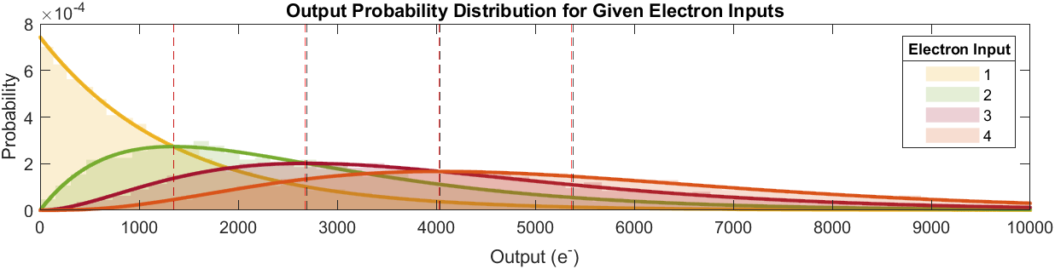
Charge Multiplication
Based on description of electron multiplication process and statistics in Basden et al., 2003 [2].
When transferring charge into a pixel with a multiplication probability greater than 0, a binomial distribution is used to determine which electrons are multiplied using the multiplication probability as the probability of success
The multiplied electrons are then added to the charge cloud
Variability of multiplication captures the Excess Noise Factor (ENF)
Plot below shows simulation of electrons multiplied through multiplication elements
Shaded histograms represent simulation output
Solid line plots shows analytical expression provided for output probability in [5]
Red dashed lines show the simulation mean output
Black dashed lines show the calculated mean output
Property | Value
Multiplication Probability | 0.012
Number of Multiplication Elements | 604
Calculated Mean Gain | 1345.95
Number of Trials per Input | 10000
Simulation adheres to ≲1% of predictions in [5]

Slide 13

Charge Measurement
Charge measurement is accomplished at the EM or standard readout register, whichever is being used
Read noise is applied using a normal distribution (zero mean, variance as specified in the detector configuration)
A bias level can also be applied to the read-out
Measurement is completed as part of a serial transfer where charge is moved out of the final pixel
The camera gain constant and digitization is applied by the Controller object

Slide 14
Assumptions & Limitations
CCD response is linear across pixel charge level
Pixel properties are not dependent on charge level, non-linearity is not modelled
Charge collection is assumed perfect
Charge diffusion is not modelled
Pixel size does not impact pixel properties
Pixel properties (such as dark current, charge diffusion, light gathering area, etc) are not explicitly tied to the provided size of the pixel

Slide 15
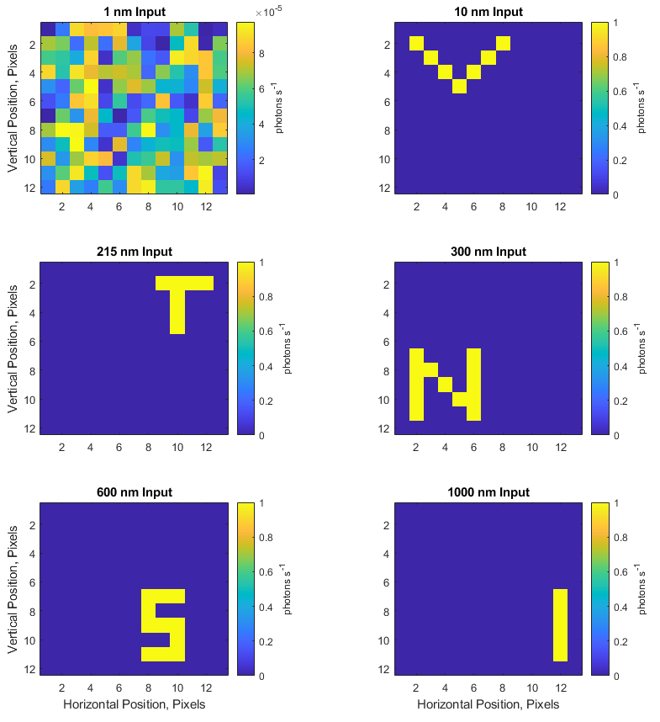
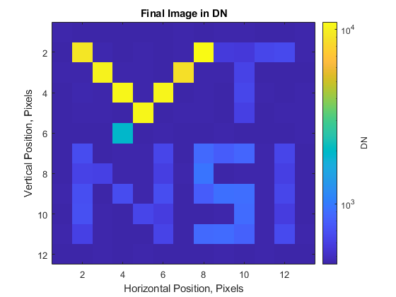
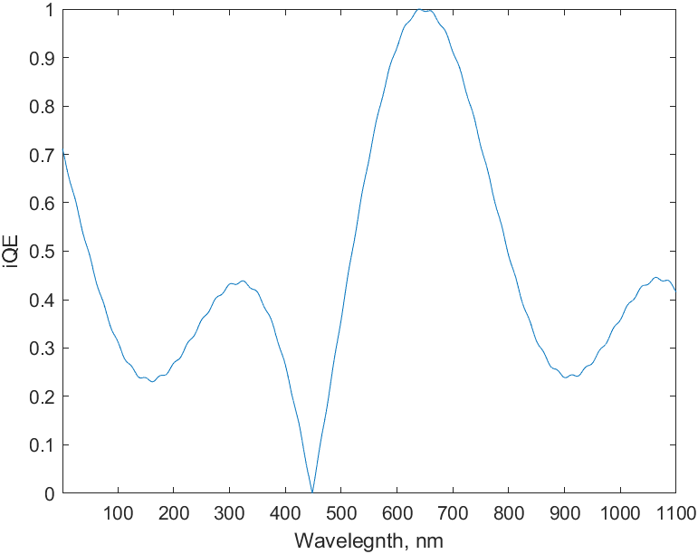
Model Operation
Model is operated through a driver function that specifies the set-up parameters for the pixels, detector, and controller

Slide 16
Model Validation – Camera Characterization
A Nuvu EM N2 camera equipped with a Teledyne e2v CCD201-20 was characterized to provide validation data for simulated characterization of the EMCCD model
Camera cooled to -85 °C using LN2
Collected data for:
Bias
Photon Transfer Curve
CIC
Dark Current
Camera was operated at 10 MHz horizontal frequency, 1 MHz vertical frequency using the EM output register
Corresponds to the default profile 1 in the CCCP software suite

Slide 17
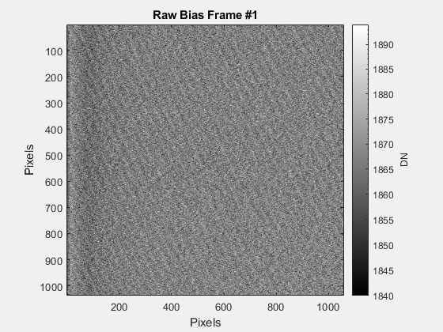
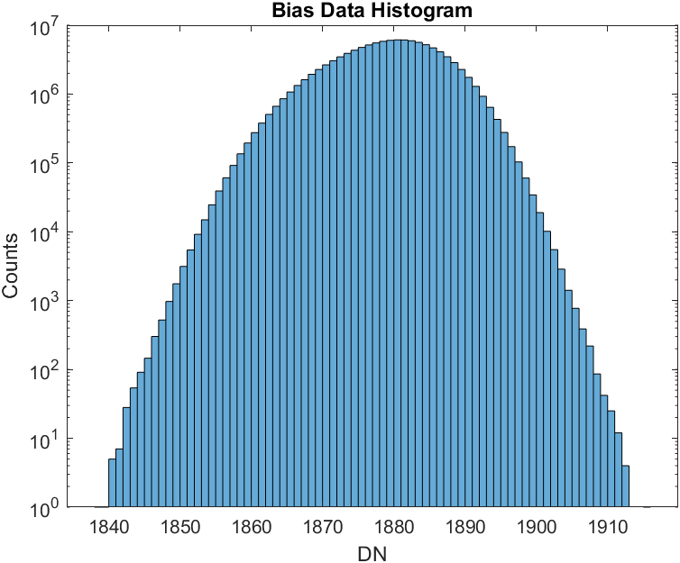
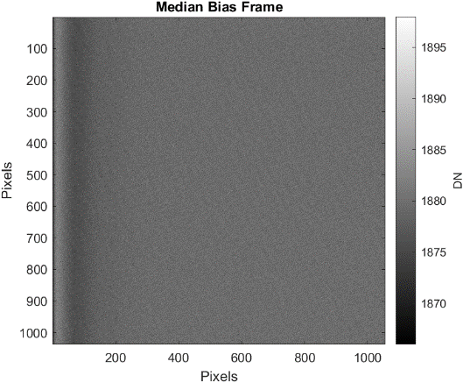
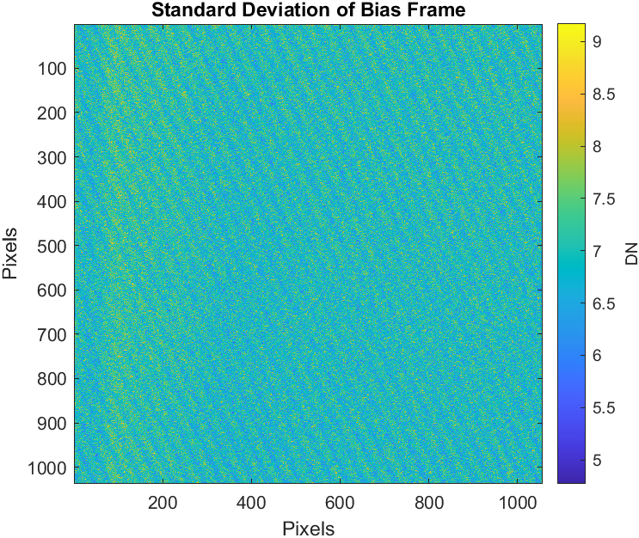
Bias Data
Collected 144 full frames using a set integration time of 0 s
Effective readout time of ~120 ms
Gain set to 1
Data collected with cap on and shutter closed
Note the use of the median bias frame to guard against impact of transient events
Adopted throughout characterization effort

Slide 18
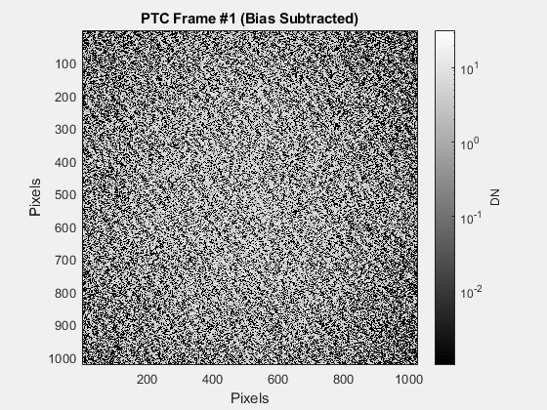
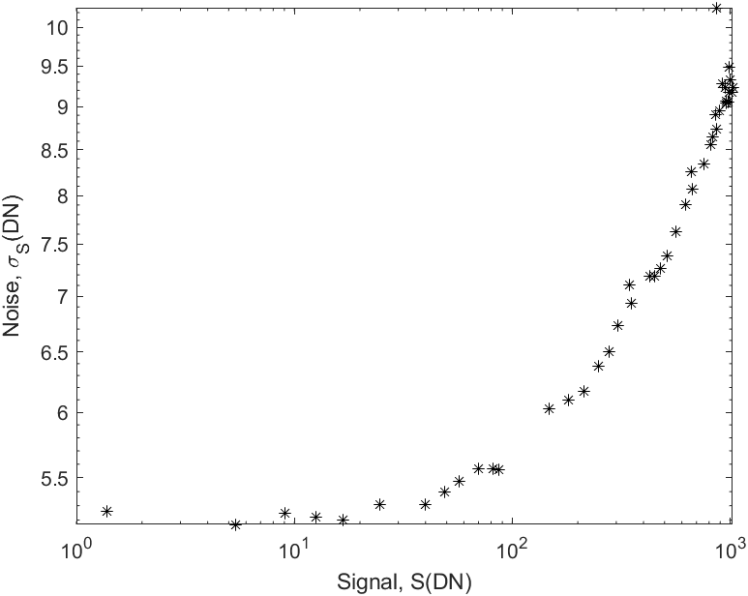
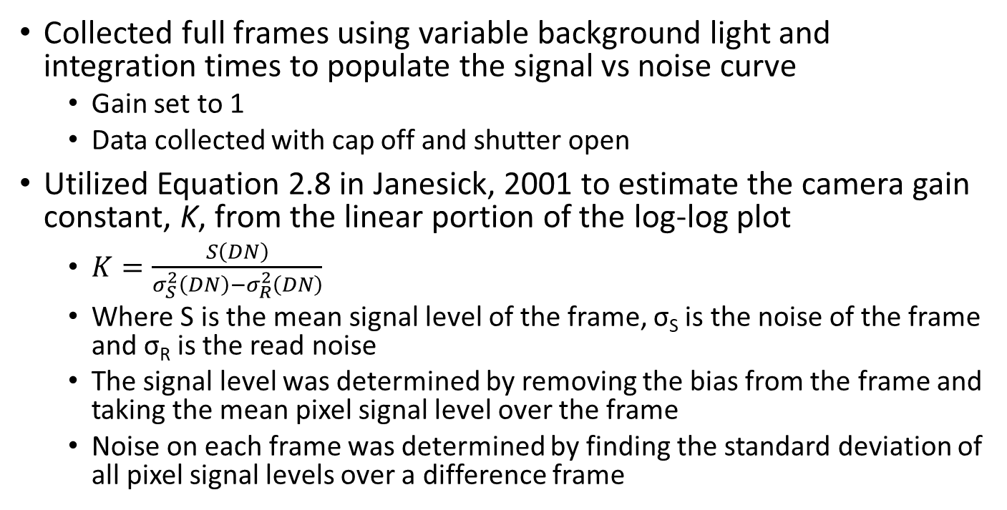
Photon Transfer Curve
Collected full frames using variable background light and integration times to populate the signal vs noise curve
Gain set to 1
Data collected with cap off and shutter open
Utilized Equation 2.8 in Janesick, 2001 to estimate the camera gain constant, K, from the linear portion of the log-log plot
$K=\frac{S\left(DN\right)}{σ_{S}^{2}\left(DN\right)−σ_{R}^{2}\left(DN\right)}$
Where S is the mean signal level of the frame, σ_{S} is the noise of the frame and σ_{R} is the read noise
The signal level was determined by removing the bias from the frame and taking the mean pixel signal level over the frame
Noise on each frame was determined by finding the standard deviation of all pixel signal levels over a difference frame
Parameter | Estimation
Read Noise (RMS) | 5.2210 DN (92.798 e⁻)
Camera Gain Constant | 17.7740 e⁻ DN⁻¹

Slide 19
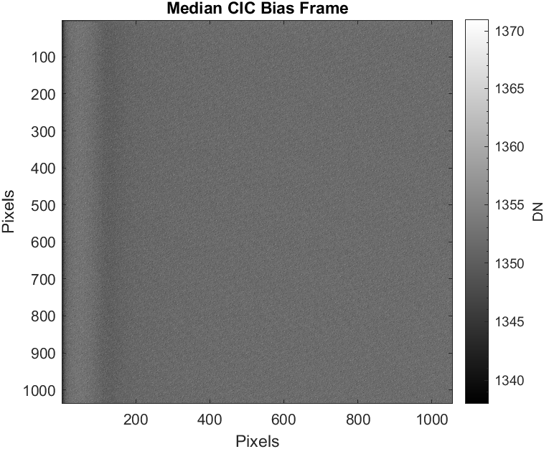
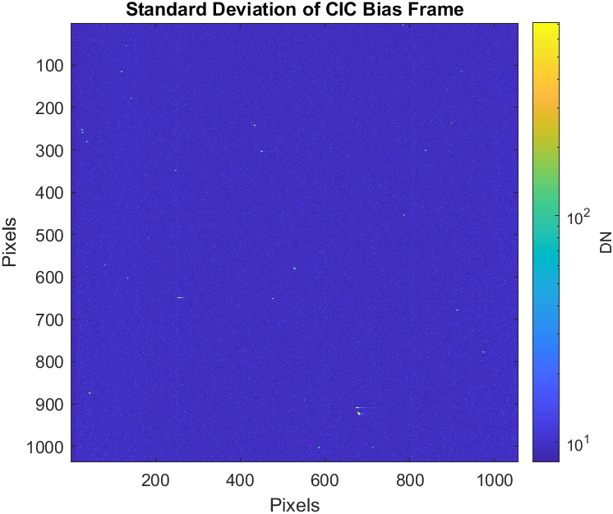
CIC Data
Collected 1000 full frames using a set integration time of 0 s and gain of 1000
Effective time of ~120 ms
Low integration time makes dark current contribution negligible
The bias frame subtracted from the CIC data was determined by taking the median pixel value over all 999 frames considered in the analysis
Bias level for the CIC data was significantly different than Bias data collected when gain was set to 0.
Median value was used over the mean to limit the impact of high signal events (muon strikes, amplified CIC electrons)
Data collected with cap on and shutter closed

Slide 20
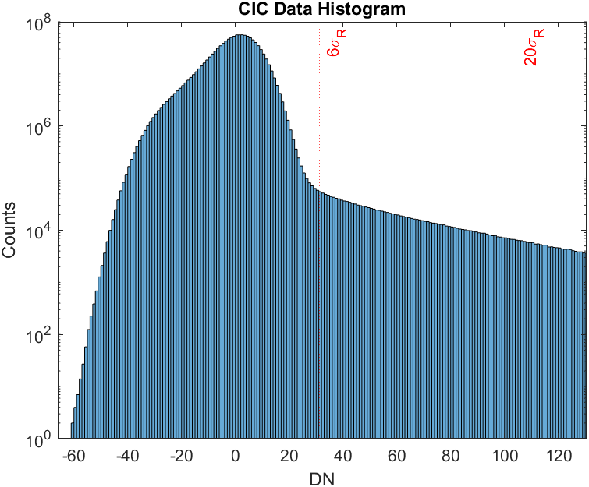
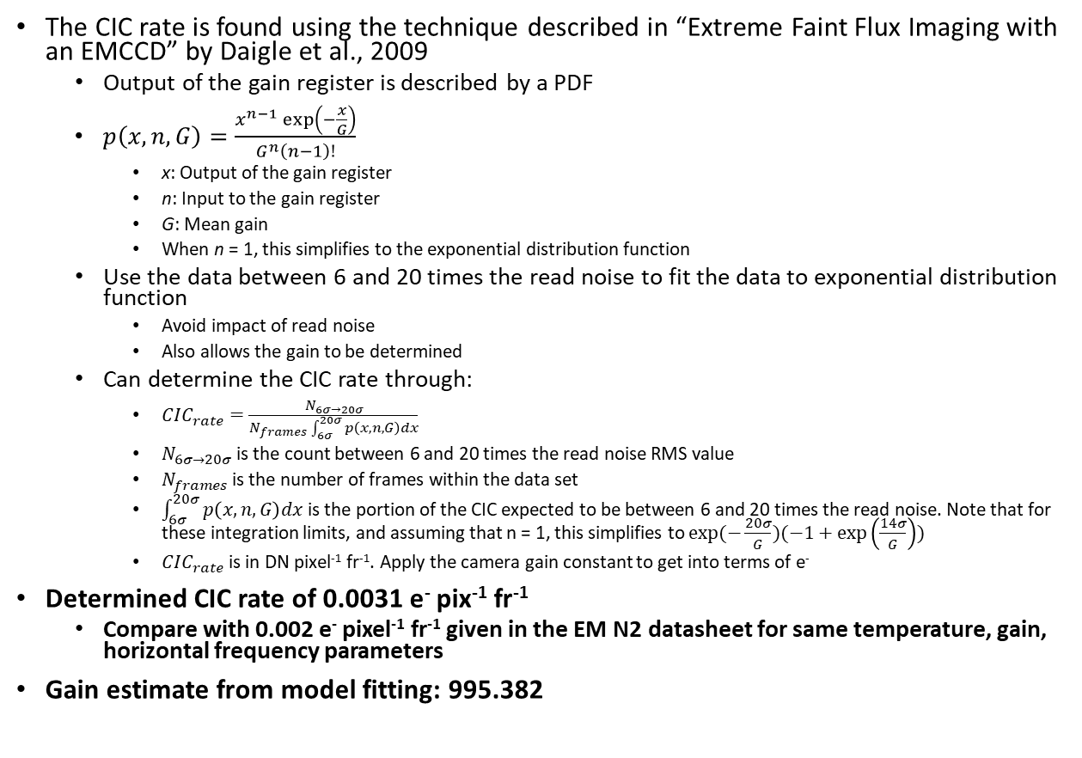
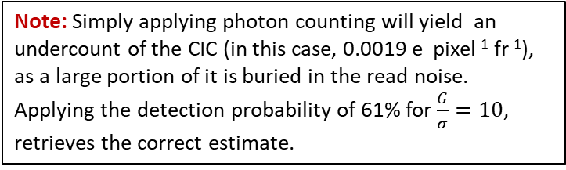
CIC Data
The CIC rate is found using the technique described in “Extreme Faint Flux Imaging with an EMCCD” by Daigle et al., 2009
Output of the gain register is described by a PDF
$p\left(x,n,G\right)=\frac{x^{n−1}\exp\left(−\frac{x}{G}\right)}{G^{n}\left(n−1\right)!}$
x: Output of the gain register
n: Input to the gain register
G: Mean gain
When n = 1, this simplifies to the exponential distribution function
Use the data between 6 and 20 times the read noise to fit the data to exponential distribution function
Avoid impact of read noise
Also allows the gain to be determined
Can determine the CIC rate through:
$CIC_{rate}=\frac{N_{6σ→20σ}}{N_{frames}\int_{6σ}^{20σ}{p\left(x,n,G\right)dx}}$
$N_{6σ→20σ}$ is the count between 6 and 20 times the read noise RMS value
$N_{frames}$ is the number of frames within the data set
$\int_{6σ}^{20σ}{p\left(x,n,G\right)dx}$ is the portion of the CIC expected to be between 6 and 20 times the read noise. Note that for these integration limits, and assuming that n = 1, this simplifies to $exp⁡(−\frac{20σ}{G})(−1+\exp\left(\frac{14σ}{G}\right))$
$CIC_{rate}$ is in DN pixel⁻¹ fr⁻¹. Apply the camera gain constant to get into terms of e⁻
Determined CIC rate of 0.0031 e⁻ pix⁻¹ fr⁻¹
Compare with 0.002 e⁻ pixel⁻¹ fr⁻¹ given in the EM N2 datasheet for same temperature, gain, horizontal frequency parameters
Gain estimate from model fitting: 995.382
Note: The derived CIC rate is well below the 0.2 event pixel⁻¹ fr⁻¹ limit for minimizing coincidence losses in photon counting, so the assumption of n = 1 is appropriate.
Note: Simply applying photon counting will yield an undercount of the CIC (in this case, 0.0019 e⁻ pixel⁻¹ fr⁻¹), as a large portion of it is buried in the read noise. Applying the detection probability of 61% for $\frac{G}{σ}=10$, retrieves the correct estimate.

Slide 21
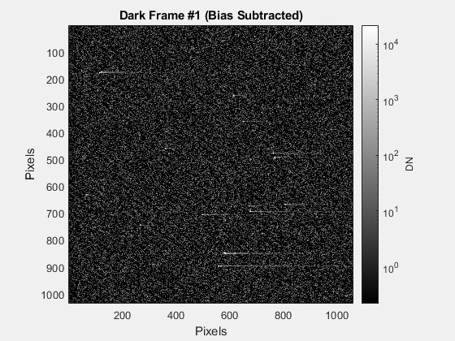
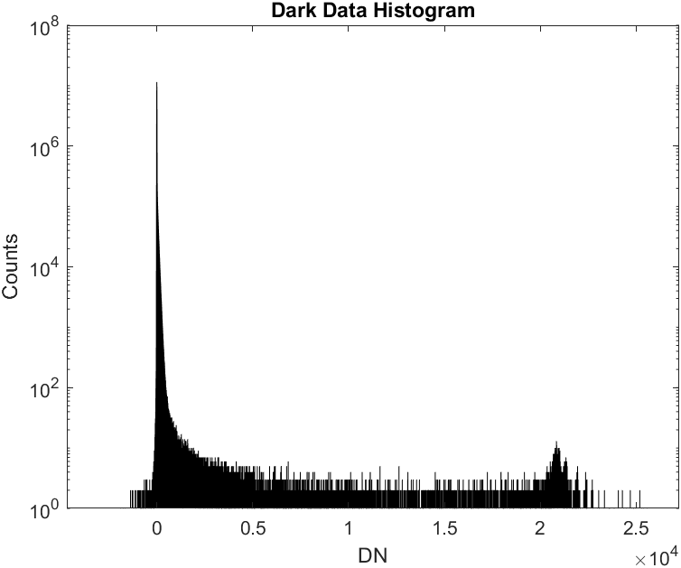
Dark Current Data
Collected 144 full frames using a set integration time of 100 s and a gain of 1000
Data collected with cap on and shutter closed
Same procedure used to find the CIC is used to determine the dark current rate
CIC rate is subtracted from the estimate to isolate the dark current component
To translate from per frame to per seconds, the value is divided by the integration time
Signal from muons striking the detector were not removed from the data
The bias frame subtracted from the dark data was determined by taking the median pixel value over all frames considered in the analysis
Bias level for the dark data was significantly different than Bias data collected when gain was set to 1.
Median value was used over the mean to limit the impact of high signal events (muon strikes, amplified dark electrons)
Peak from muon strikes on the detector

Slide 22
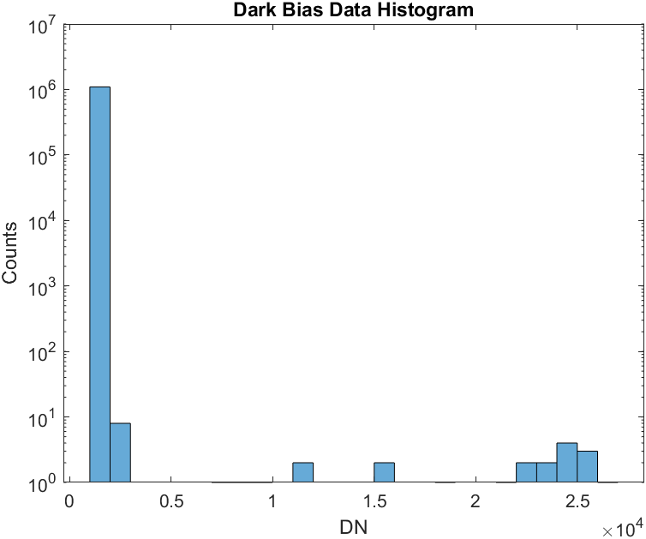
Dark Current Data
Some “hot” pixels are observed on the detector
Row 198, Column 310
Line of hot pixels on Row 2, starting on column 1 and extending through the columns
Dark current estimate: 7.0685e-4 e⁻ pixel⁻¹ s⁻¹
Compare with 4e-4 e⁻ pixel⁻¹ s⁻¹ given in the EM N2 datasheet or 5e-4 e⁻ pixel⁻¹ s⁻¹ given by Harding et al., 2016 for the same temperature
Gain estimate: 1042.0
Hot pixels
Note: Using the derived dark current rate, expect 7.0685e-2 e⁻ pix⁻¹ fr⁻¹ during data collection, well below the 0.2 event pixel⁻¹ fr⁻¹ limit for minimizing coincidence losses in photon counting, so the assumption of n = 1 is appropriate.

Slide 23
Model Validation – Characterization Simulation
Simulating the previous characterization campaign using the EMCCD Simulator in MATLAB
Use the test results, EM N2 camera datasheet, and CCD201-20 data sheet to fill-out the simulated detector parameters
Will be collecting data for:
Bias
Photon Transfer Curve
CIC
Dark Current
Will also be demonstrating quantum yield characterization

Slide 24
Model Parameters
Parameter | Value | Source
Parallel Section Length | 50 pixels | *
Parallel Section Width | 50 pixels | *
Overscan Elements | 16 pixels | +
Standard and Corner Elements | 16 pixels | *
Multiplication Elements | 50 pixels | *
EM Read Noise | 92.798 e⁻ | ^
Parallel Section Full Well Capacity | 80000 e⁻ | +
Serial Section Full Well Capacity | 730000 e⁻ | +
CTE | 0.999989 | ‘
Dark Current Rate | 7.0685 e⁻ pixel⁻¹ sec⁻¹ | ^
CIC Rate | 0.0031 e⁻ pixel⁻¹ fr⁻¹ | ^
Camera Gain Constant | 17.7740 e⁻ DN⁻¹ | ^
ADC Resolution | 16 bits | ‘
Vertical Frequency | 1 MHz | *
Horizontal Frequency | 10 MHz | *
*: Specified
+: CCD201-20 Datasheet
^: From Characterization
‘: From EM N2 Camera Datasheet
Note: A reduced detector size is used in the simulation for the sake of minimizing processing time. This does not impact the behavior of the simulator as compared to a real detector, except for the reduction in the number of multiplication elements, which does alter the shape of the output distribution. This is important for CIC and dark current analysis, as the probability distribution function described in previous slides assumes a large number of multiplying elements. It will be seen that the simulator is still able to well approximate the detector behavior, however this may be a source of deviations from realistic detector operation. See the slide “Output Probability Distribution vs Number of Multiplication Elements” at the end of the slide deck for more information.
Note: For simulating CIC, the rate must be translated from per frame to per transfer. This is accomplished by dividing the CIC rate by the average number of transfers for pixels in the image section.

Slide 25
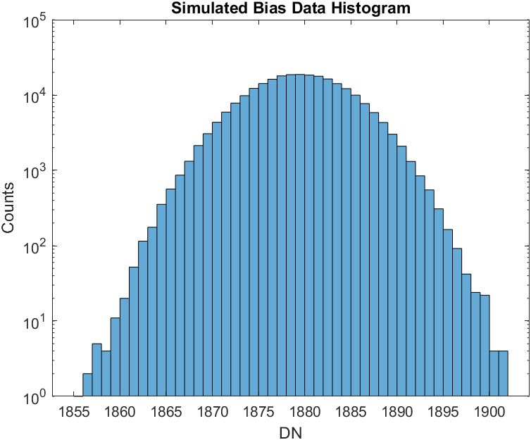
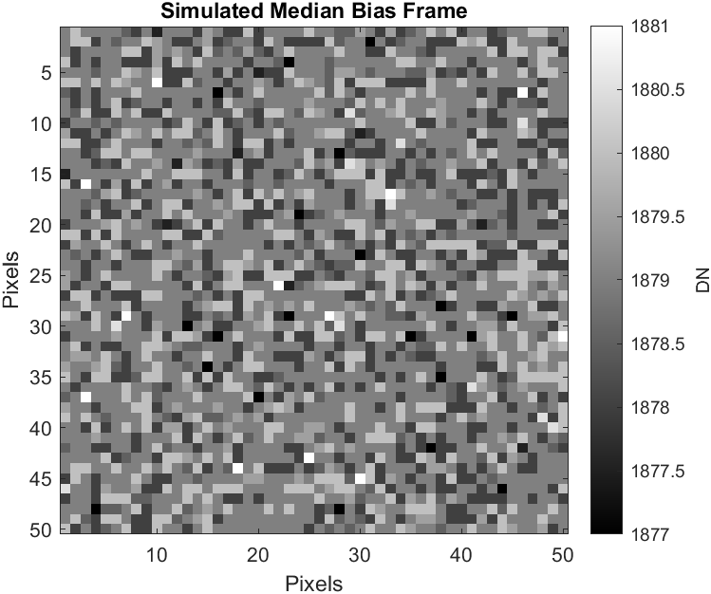
Bias Simulation
Comparison of the bias curve generated from camera data and the simulation show the two are similar, though the camera data is not precisely Gaussian in distribution
Note the lack of fixed pattern noise in the bias frame
Parameter | Value | Source
Bias Level | 33397.346 e⁻ | ^
Gain | 1 | *
Number of Bias Frames | 100 Frames | *

Slide 26
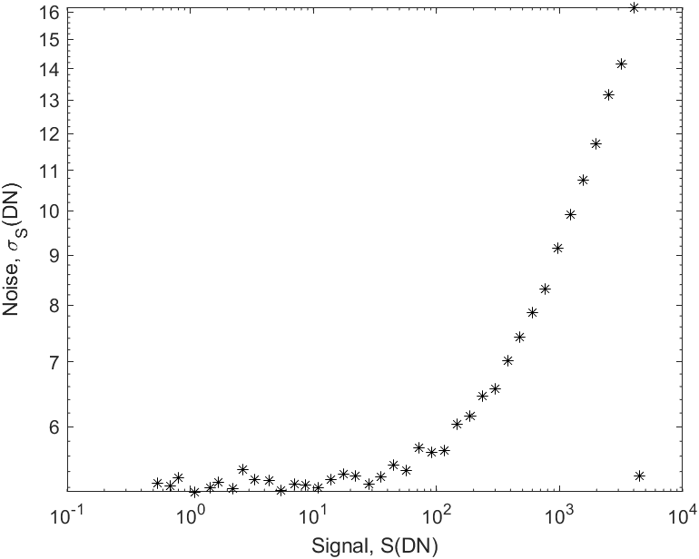
PTC Simulation
PTC data was taken for exposure times spanning 4 orders of magnitude using 40 sample points, spaced logarithmically
The simulated light was set to a wavelength of 600 nm with an interacting quantum efficiency of 90% and quantum yield of 1
Observe that at saturation, the noise level immediately drops to the read noise floor
This is because the model does not include non-linearity in charge collection and transfer as a function of the amount of charge in a pixel
Read Noise Regime
Saturated Frame
Parameter | Specified | Simulated Measurement
Read Noise | 5.2210 DN | 5.2449 DN
Camera Gain Constant | 17.6665 e⁻ DN⁻¹ | 17.6306 e⁻ DN⁻

Slide 27
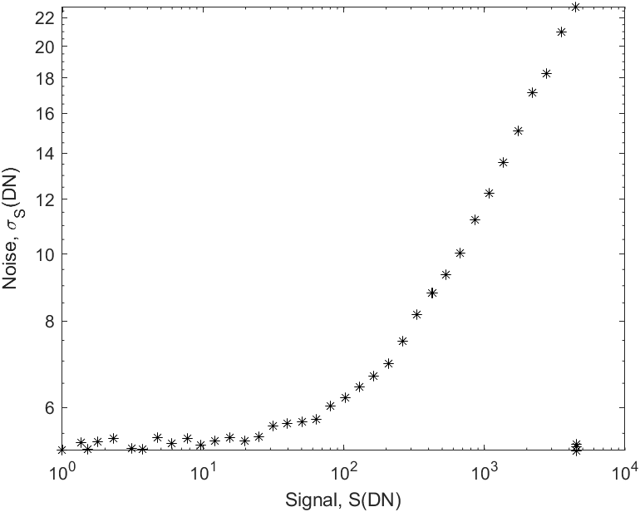
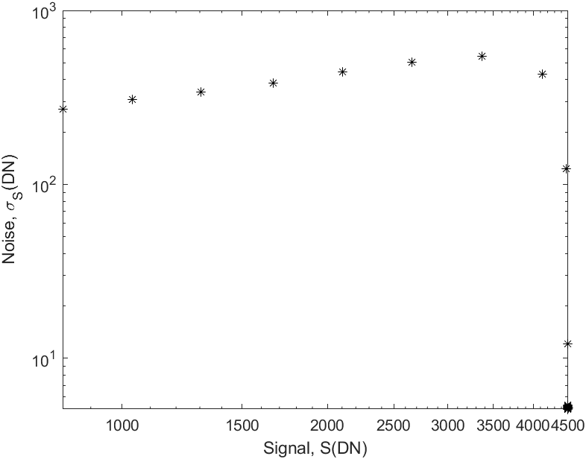
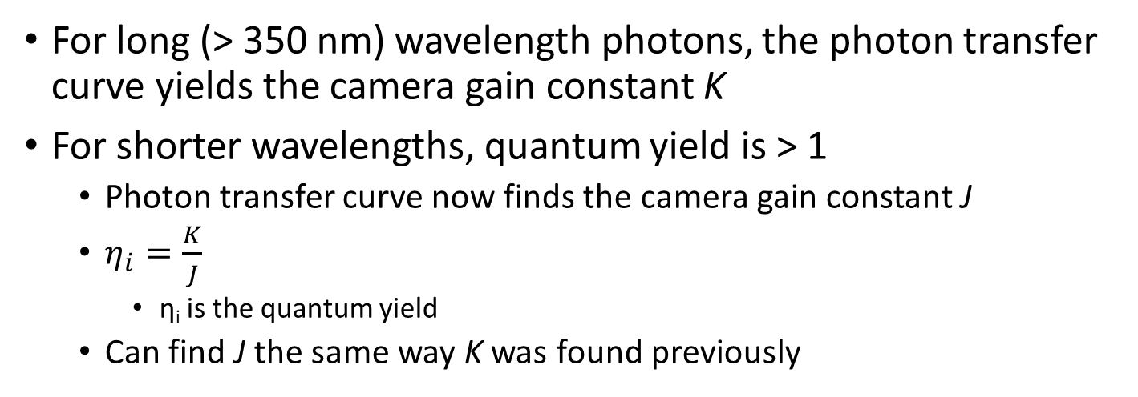
Quantum Yield Measurements
For long (> 350 nm) wavelength photons, the photon transfer curve yields the camera gain constant K
For shorter wavelengths, quantum yield is > 1
Photon transfer curve now finds the camera gain constant J
$η_{i}=\frac{K}{J}$
η_{i} is the quantum yield
Can find J the same way K was found previously
λ = 175 nm
λ = 0.21 nm
Wavelength (nm) | Nominal Quantum Yield | Simulated Measurement | Error (%)
175 | 1.79 | 1.99 | 11.2
0.21 | 1616.44 | 1615.82 | -0.03
Note: While this looks like non-linearity, this is more likely saturation of individual pixels that then drops their noise level to the read noise floor
Note: Real measurements of the quantum yield at 0.21 nm will yield a lower value (1420 e⁻ per interacting photon according to Janesick, 2001) due to the effect of charge collection efficiency. This is not modelled by the (EM)CCD Model, and so approximately the nominal value is recovered.

Slide 28
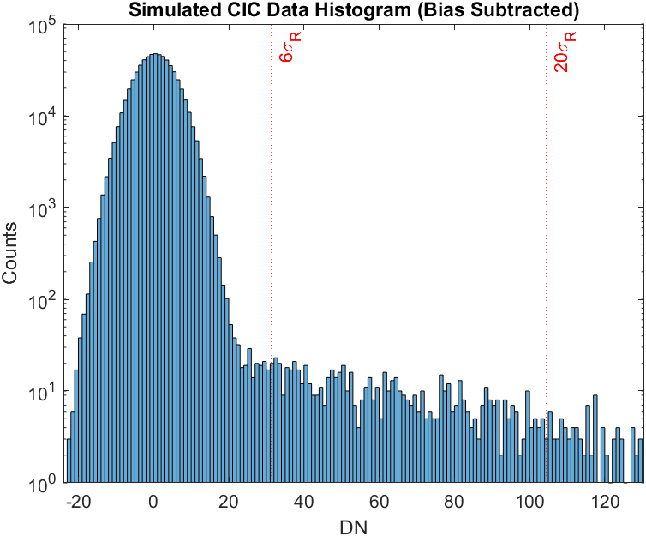
CIC Simulation
For CIC simulation, the size of the detector parallel section was reduced to 25 x 25 pixels
In order to simulate the CIC, the measured CIC rate must be converted from per frame, to per transfer
Allows the model to simulate CIC on a per pixel basis, in keeping with the working of the rest of the model
Divide the per frame CIC rate by the average number of transfers a pixel will undertake in the readout sequence
Measured CIC: 0.0031 e⁻ pixel⁻¹ fr⁻¹
Simulated CIC: 0.0027 e⁻ pixel⁻¹ fr⁻¹
% Difference: -12.9%
Retrieved Gain: 1073.2
Parameter | Value | Source
Bias Level | 24030.448 e⁻ | ^
Gain | 1000 | *
Number of CIC Frames | 1000 Frames | *

Slide 29
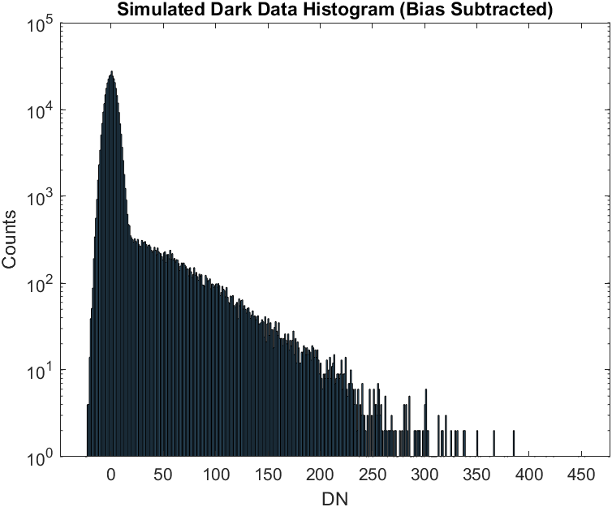
Dark Current Simulation
Note that the effect of muon impacts on the detector are not included in the simulation
“Hot” pixels are also not simulated, though the model is capable of doing so if desired
Measured Dark Current: 7.0685e-4 e⁻ pixel⁻¹ s⁻¹
Simulated Dark Current: 7.7979e-4 e⁻ pixel⁻¹ s⁻¹
% Difference: 10.3%
Retrieved Gain: 1080.9
Parameter | Value | Source
Bias Level | 23657.194 e⁻ | ^
Gain | 1000 | *
Number of CIC Frames | 144 Frames | *
Integration Time | 100 s | *

Slide 30
Summary & Future Work
A model has been developed in MATLAB to simulate each step of the CCD readout process
Allows for treatment of pixel level noise and charge transfer properties
Enables virtual simulation of realistic read-out sequences
Image read-out
Detector characterization
Performance degradation studies
Etc.
Future work will focus on increasing model fidelity, quality-of-life improvements, optimizing performance
Treatment of pixel blooming / charge diffusion
Extend trap modeling
Cosmic ray impacts
Ability to incorporate time-dynamic input and pixel properties

Slide 31
References
[1] Janesick, J. Scientific Charge-Coupled Devices. SPIE Press, Bellingham, WA, 2001.
[2] Kuschnerus, P., Rabus, H., Richter, M., Scholze, F., Werner, L., and Ulm, G. “Characterization of Photodiodes as Transfer Detector Standards in the 120 Nm to 600 Nm Spectral Range.” Metrologia, Vol. 35, No. 4, 1998, pp. 355–362. https://doi.org/10.1088/0026-1394/35/4/23.
[3] McLean, I. Electronic Imaging in Astronomy - Detectors and Instrumentation. Praxis Publishing, Chichester, UK, 2008.
[4] Scott, A., Beaton, A., Roy, N., Côté, P., and Hutchings, J. “NUV Performance of E2v Large BICMOS Array for CASTOR.” High Energy, Optical, and Infrared Detectors for Astronomy VII, Vol. 9915, No. July 2016, 2016, p. 99151T. https://doi.org/10.1117/12.2231750.
[5] Basden, A. G., Haniff, C. A., and Mackay, C. D. “Photon Counting Strategies with Low-Light-Level CCDs.” Vol. 991, 2003, pp. 985–991.
[6] Harding, L. K., Demers, R. T., Hoenk, M., Peddada, P., Nemati, B., Cherng, M., Michaels, D., Neat, L. S., Loc, A., Bush, N., Hall, D., Murray, N., Gow, J., Burgon, R., Holland, A., Reinheimer, A., Jorden, P. R., and Jordan, D. “Technology Advancement of the CCD201-20 EMCCD for the WFIRST Coronagraph Instrument: Sensor Characterization and Radiation Damage.” Journal of Astronomical Telescopes, Instruments, and Systems, Vol. 2, No. 1, 2015, p. 011007. https://doi.org/10.1117/1.jatis.2.1.011007.

Slide 32
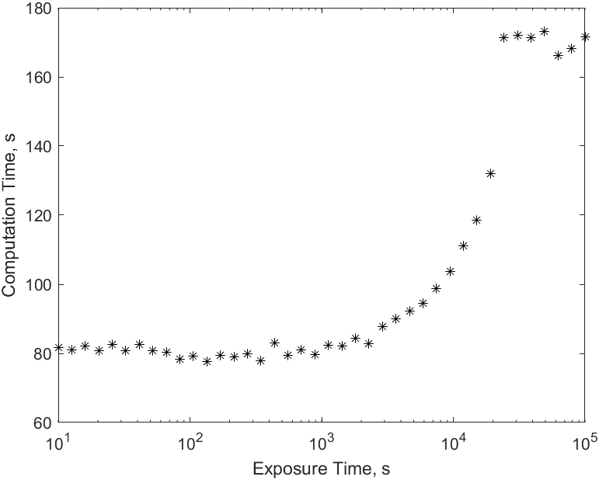
Note on Computation Time
Tracked computation time for a EMCCD readout during the PTC simulations
Note that the computation time for an exposure increases as more signal builds on a detector
The break from exponential growth is due to the model switching to using GPU processing for binomial random number generation
Computation time increases with the size of the detector, the number of serial elements, and the signal level within the pixels

Slide 33
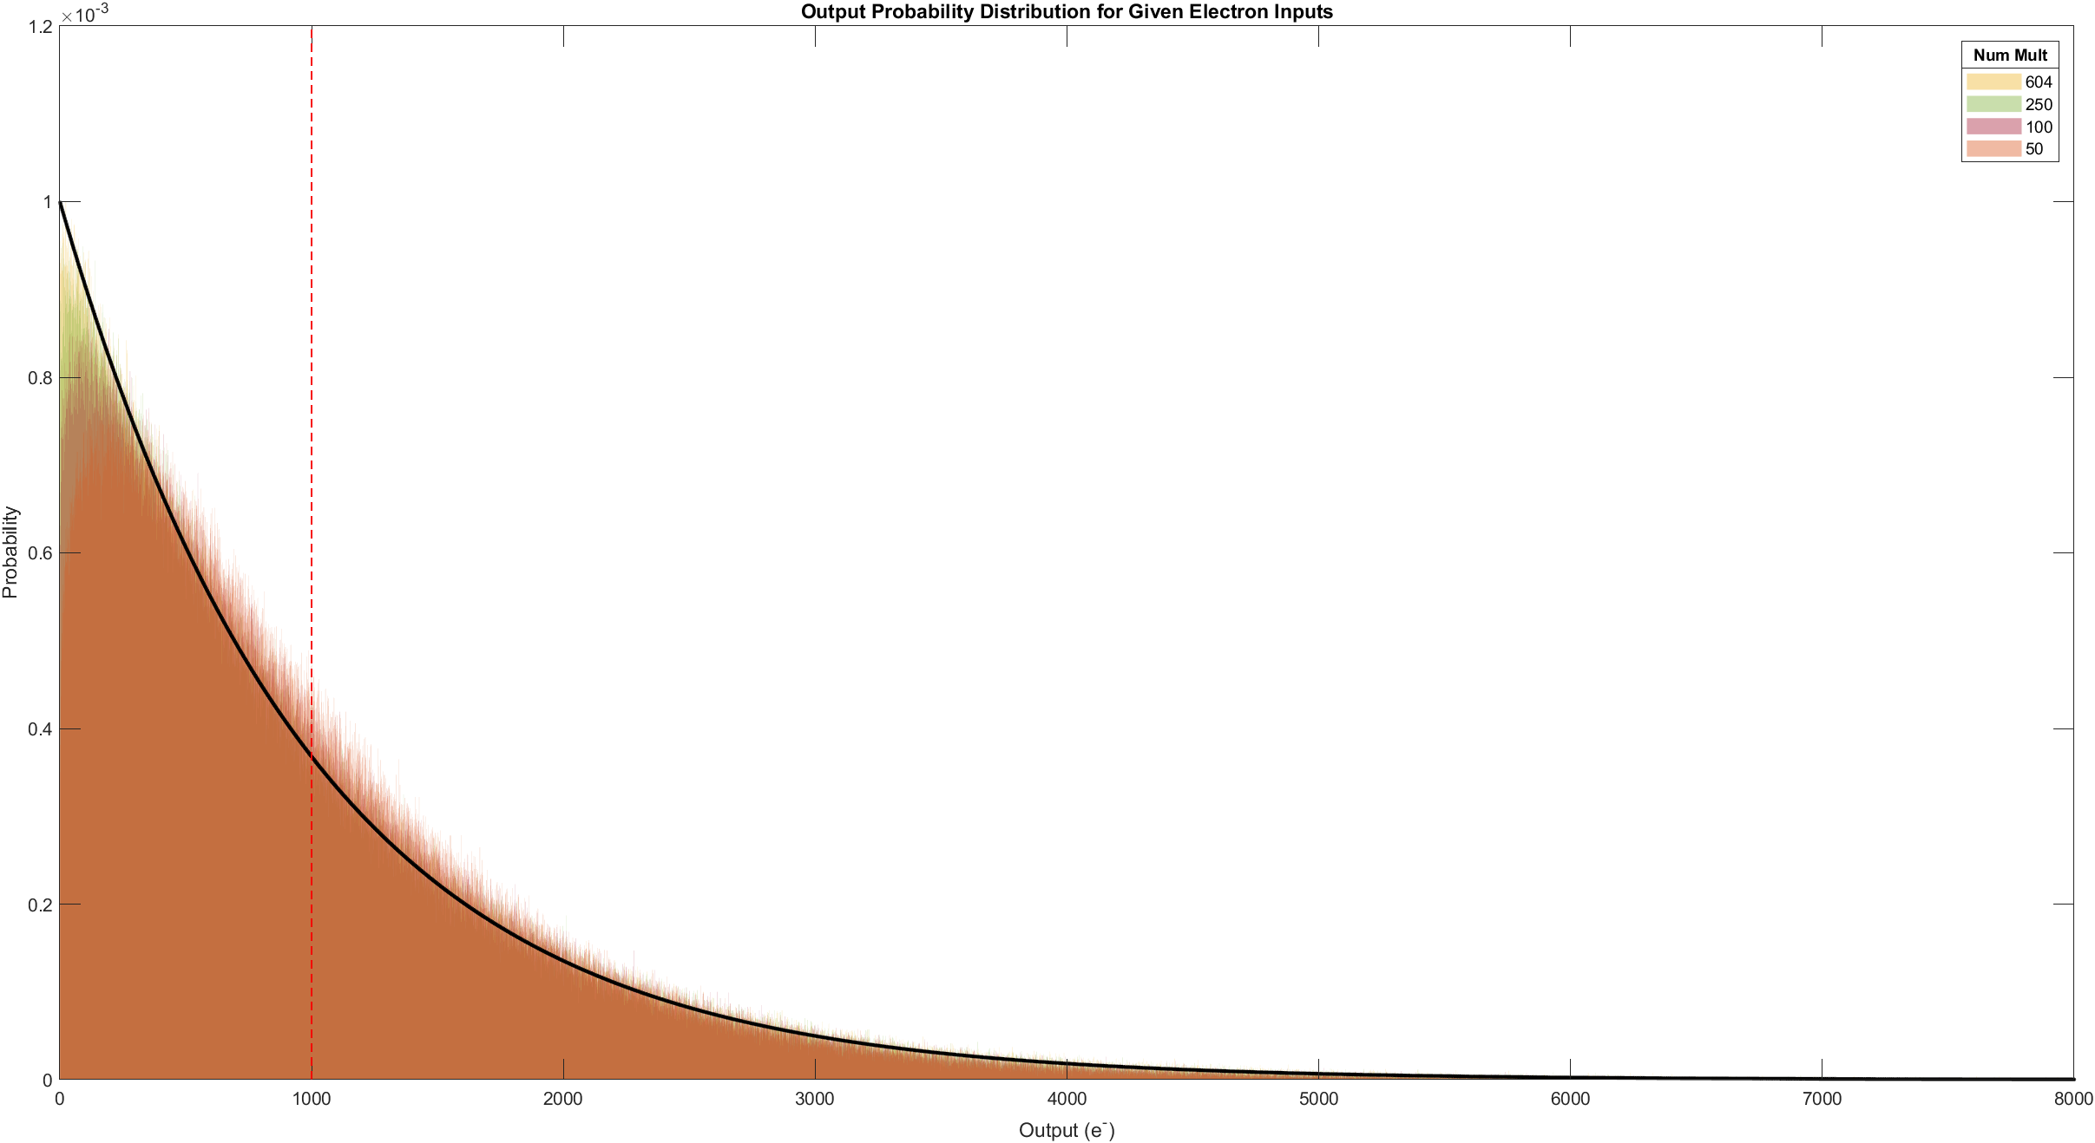
Output Probability Distribution vs Number of Multiplication Elements
Note: As the number of multiplication elements is decreased, for a constant mean of 1000, the distribution tends to separate from the y-axis, with a higher portion of events being significantly multiplied. The calculated average gain remains constant. This would have the effect of pulling more events out from the read noise in a detector readout

